Slide 1
Cohort Studies
Jiyu Baek, Joon Kim, Terry Kim
Notes:
Hello everyone. Today we’ll present two related studies —“A single-cell atlas of anti–PD-1-treated NSCLC,” and MrVI.
Our goal is to show how cohort-based single-cell analyses can reveal patterns of immune heterogeneity that explain why some patients respond to immunotherapy while others don’t.
I’ll begin with what a cohort is and why this study design is key to understanding tumor–immune variation, before we move into the data and the results.

Slide 2
Outline
Cohorts
What are cohorts?
Why cohorts?
Atlas Study (Liu et al.)
Background & Study Design
TIME Subtype Discovery
Functional and Survival Insights
Clinical Implications
MrVI (Boyeau et al.)
scVI Recap
Challenges in scVI
MrVI: An intuition
Case studies

Slide 3
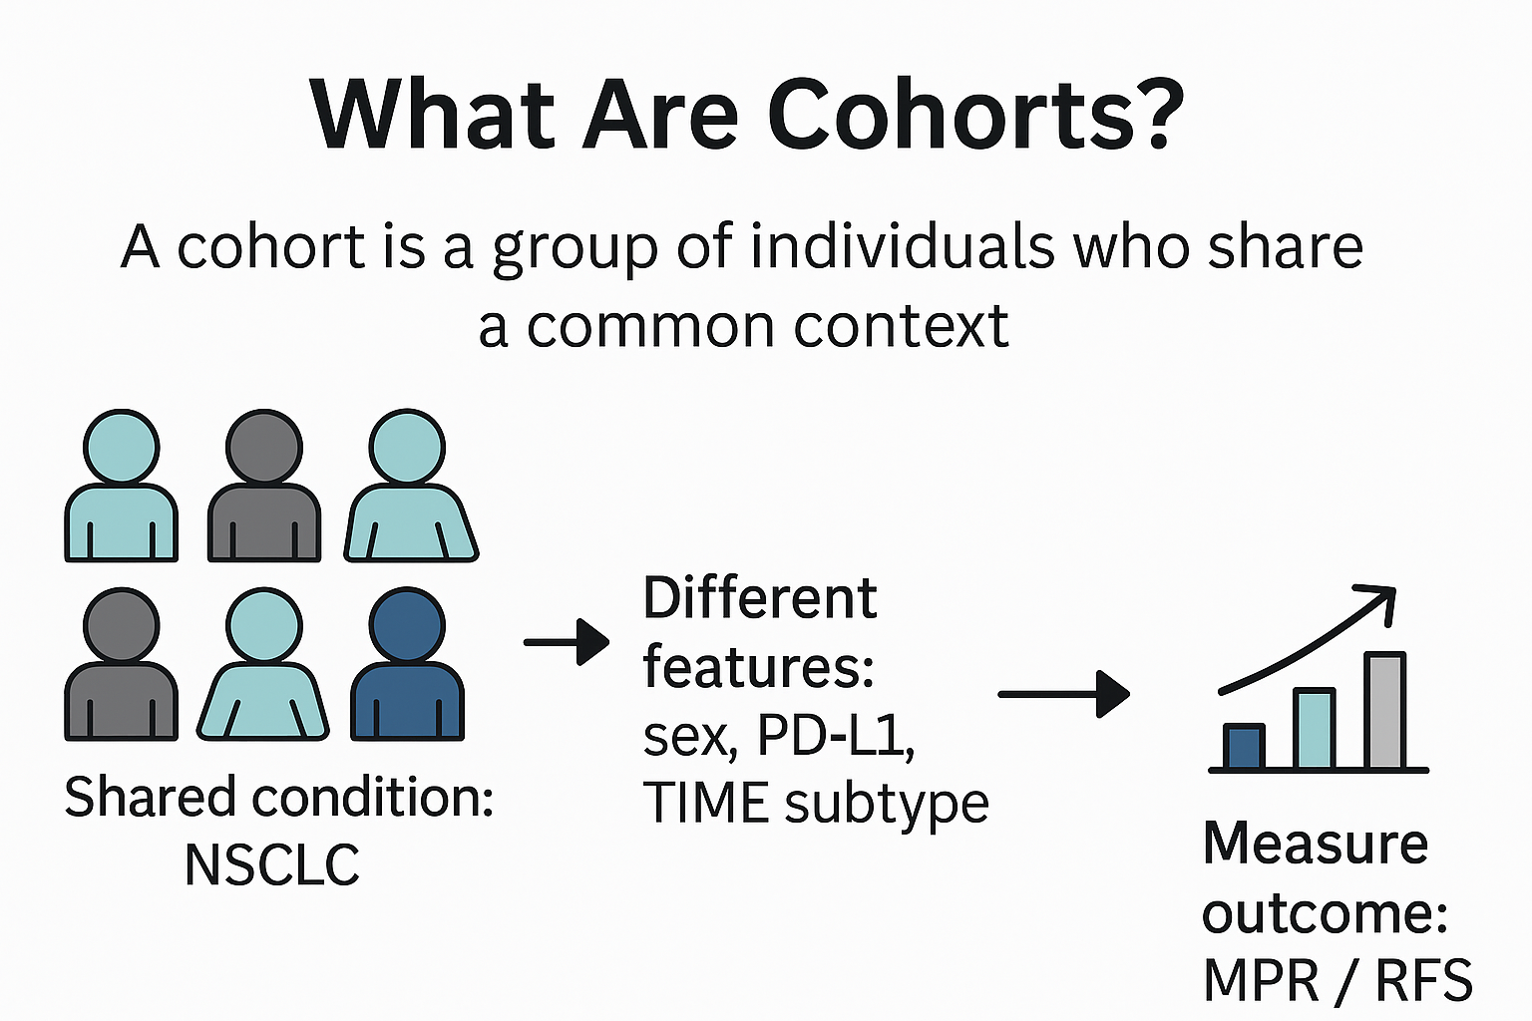
Notes:
A cohort is a group of individuals who share a common condition — for example, patients diagnosed with the same disease or receiving the same therapy. In this study, the cohort consisted of 234 patients with non-small-cell lung cancer (NSCLC) who received neoadjuvant anti-PD-1 therapy combined with chemotherapy.
Studying such a large cohort allows the researchers to link molecular-level profiles — like each patient’s immune-cell composition, gene-expression pattern, or TCR clonotypes — to their clinical outcomes, such as pathologic response or recurrence-free survival. In other words, they can connect what’s happening inside the tumor at the cellular level with what happens to the patient after treatment.
Of course, not all variation in a human cohort directly reflects the biology we want to study. Some variation comes from biological covariates — things like age or sex These are real biological traits, but they can act as confounding factors, because they influence immune composition in ways that are independent of therapy response.
Other variation comes from technical factors, such as sequencing depth, sample batch, or platform differences — these are purely experimental noise that should be corrected.
By analyzing hundreds of patients together, the study can statistically separate these two sources of variation — controlling for biological covariates and normalizing technical noise — so that the true signal stands out: the relationship between tumor immune architecture and clinical response.
Once those confounding factors are accounted for, the remaining differences between patients — the ones that reflect how their immune environments are truly built — become highly meaningful.
And that’s exactly what the next part is about: how a cohort-based single-cell study turns patient-to-patient diversity into biological insight.

Slide 4
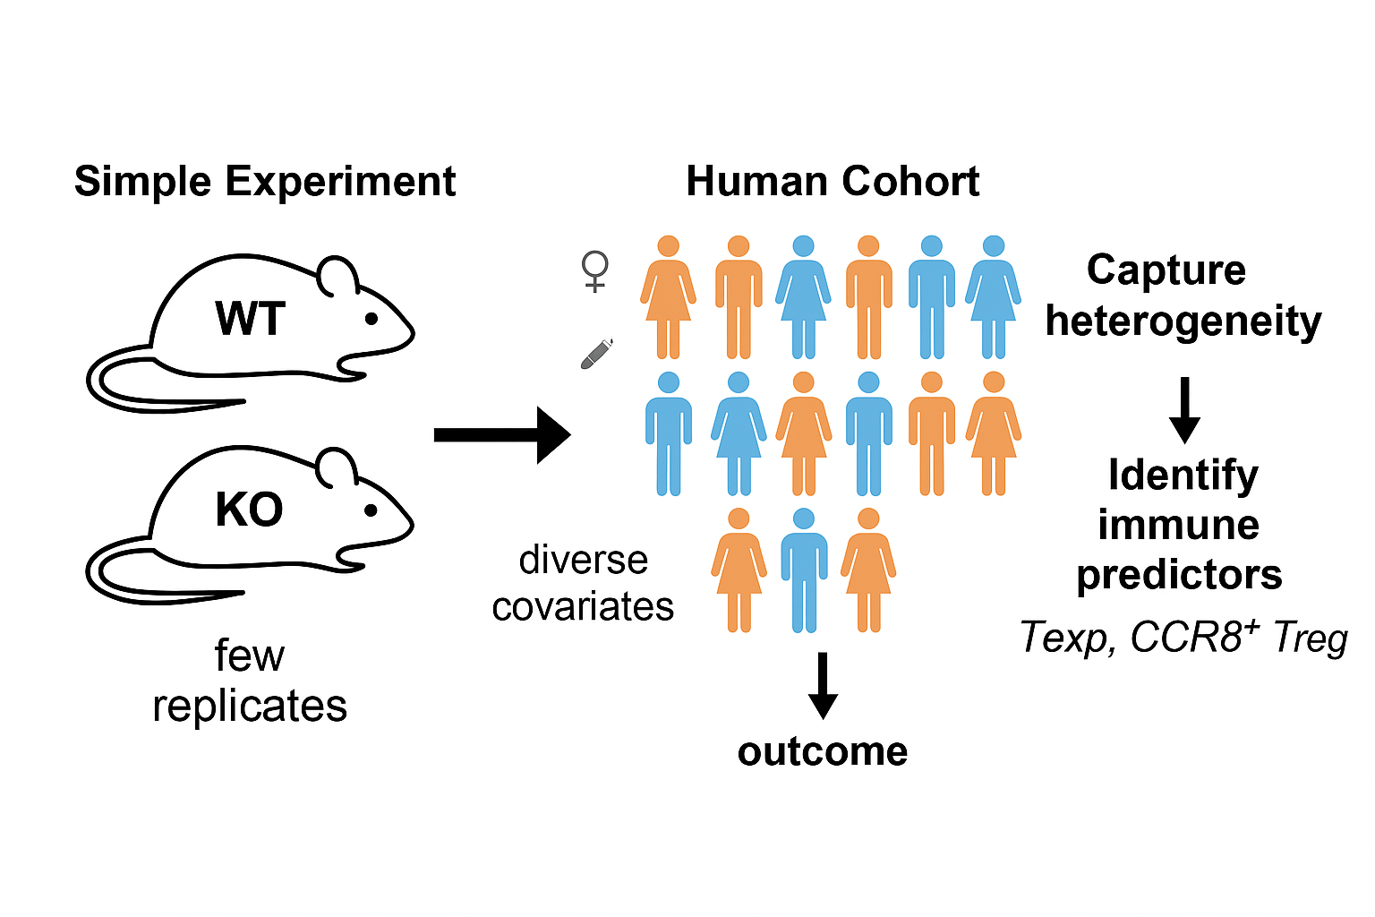
Why a Cohort-Based Single-Cell Study Matters
Notes:
Most single-cell studies focus on within-sample variability — for example, how T cells, macrophages, and B cells interact inside one tumor. That approach is powerful, but it can’t tell us why different patients respond differently to the same treatment.
A cohort-based single-cell study expands that view. Instead of looking at a single tumor, we analyze hundreds, each representing a unique immune ecosystem. This lets us explore between-patient variability — the kind of heterogeneity that defines clinical outcomes. By scaling single-cell data to the level of populations, we move from describing cell types to explaining why some immune architectures lead to better responses.
So, rather than eliminating diversity, cohort studies use it as data. They transform single-cell sequencing from a purely descriptive tool into a predictive framework that links molecular structure to therapeutic effect — which is precisely the goal of the this paper.
To see why this approach matters, think of the difference between a controlled mouse experiment and a human cohort. In a mouse experiment, variables are fixed and outcomes are easy to interpret — perfect for mechanistic questions.
In human studies, no two patients are ever the same. Each person differs in genetic background, and tumor environment, and that’s exactly what makes cohort studies powerful — they capture real biological diversity.
Of course, some of that diversity comes from confounding covariates, which we can control statistically. But once those effects are accounted for, the remaining variation — the true biological heterogeneity — carries valuable information.
Instead of treating that heterogeneity as noise, cohort studies treat it as data: it’s the key to understanding why some tumors respond to immunotherapy while others resist.
This perspective sits at the heart of this single cell atlas paper. By studying a large, diverse NSCLC population, the authors identified immune patterns that consistently appeared across individuals and linked those patterns to real-world clinical outcomes. In other words, after controlling for irrelevant noise, they embraced meaningful variability to uncover the biology behind therapeutic success.

Slide 5
Outline
Cohorts
What are cohorts?
Why cohorts?
Atlas Study (Liu et al.)
Background & Study Design
TIME Subtype Discovery
Functional and Survival Insights
Clinical Implications
MrVI (Boyeau et al.)
scVI Recap
Challenges in scVI
MrVI: An intuition
Case studies
Notes:
So now that we understand why a cohort framework is powerful, let’s look at how this idea plays out in practice.

Slide 6
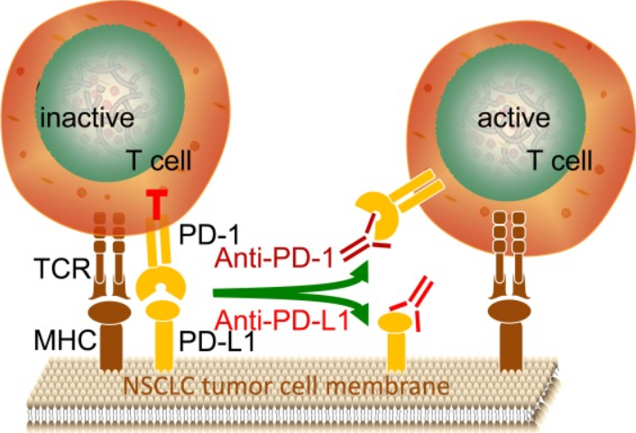
Clinical Background and Rationale
NSCLC ≈ 85 % of lung cancer cases (LUAD vs LUSC)
PD-1/PD-L1 blockade has transformed therapy, but response rates ≈ 30–40 %
Hypothesis: Tumor immune microenvironment (TIME) heterogeneity drives differential responses
MPR (major pathologic response) and RFS (recurrence-free survival) as clinical results
(Zhu et al., 2020)
Notes:
This paper applies it to a real clinical setting — non-small-cell lung cancer, or NSCLC, which makes up about 85 percent of lung cancers and includes LUAD which is adenocarcinoma ,and LUSC, which is squamous carcinoma based on histology
In NSCLC, anti-PD-1 immunotherapy has changed the treatment landscape, but only about 30 to 40 percent of patients achieve a strong pathological response. This dramatic difference in outcome naturally raises a question: why do some tumors respond while others do not, even under the same therapy?
The authors proposed that the key lies in the tumor immune microenvironment, or TIME — the network of immune cells surrounding the tumor. If the TIME differs between patients, those differences might explain the variation in treatment response. And that idea leads us to the design of their study — an effort to connect the immune landscape of each tumor to its clinical outcome.

Slide 7
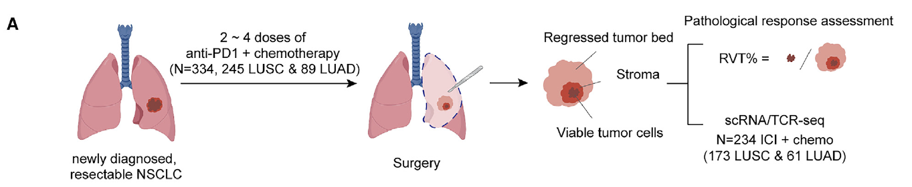
Study Design and Cohort
234 patients with resectable NSCLC treated with neoadjuvant anti-PD-1 + chemotherapy
Samples collected at surgery → tumor, lymph node, and blood
1.25 million cells analyzed by scRNA-seq + scTCR-seq
Integration and NMF-based clustering(based on immune cell frequencies) to define immune modules
Notes:
Now that we understand the motivation behind the study, let’s look at how it was actually designed. The cohort consisted of 234 NSCLC patients who received neoadjuvant anti–PD-1 therapy combined with chemotherapy before surgical resection. Tumor, lymph-node, and blood samples were collected from each patient to profile their immune landscapes at single-cell resolution and this figure summarizes the workflow. After therapy, the resected tumors were pathologically examined to measure the Residual Viable Tumor percentage, or RVT%. RVT% represents the fraction of living tumor tissue remaining after treatment, calculated as
\text{RVT%} = \frac{\text{viable tumor area}} divided by {\text{total tumor bed area}} \times 100 .
This number directly reflects how much of the tumor survived therapy — lower RVT% means better response, and patients with RVT ≤(less than or equal to) 10 % are classified as having a Major Pathologic Response (MPR). This metric became the key clinical outcome for evaluating treatment efficacy across the cohort.
In parallel, the authors generated over 1.25 million single-cell RNA seq data from these samples, capturing each patient’s immune composition in unprecedented detail. To uncover structure in this vast dataset, they used Non-negative Matrix Factorization (NMF) — a mathematical approach that identifies hidden patterns by decomposing a data matrix into underlying components. Unlike the cNMF we’ve learned from class, which extracts gene programs, this analysis was performed on immune-cell frequencies across patients — asking, essentially, “which immune-cell types tend to appear together across tumors?”
By repeating NMF under multiple subsampling conditions, the authors found five stable modules — recurring combinations of immune cells that represent distinct immune ecosystems. These modules defined the five TIME subtypes, which we’ll see in the next figure. So, this single design — linking quantitative pathology explained by RVT% with quantitative immune composition (NMF modules) — forms the backbone of the entire study.

Slide 8
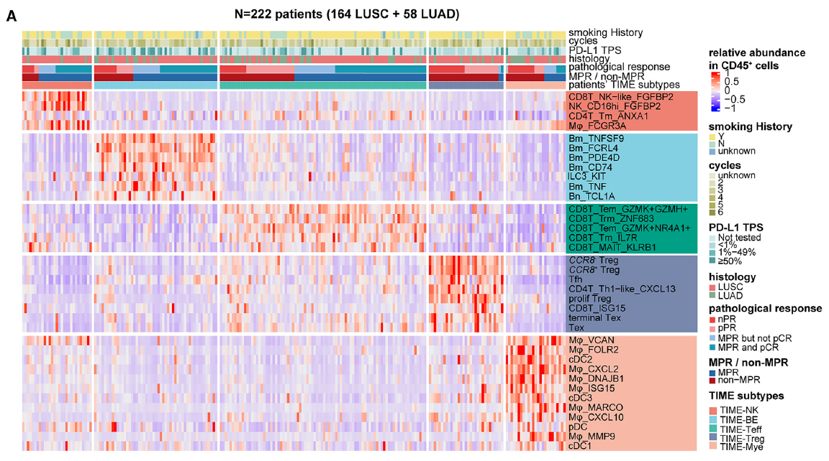
Identification of 5 TIME Subtypes
Tumor(patient)
Immune cell type
TIME-NK
TIME-BE
TIME-Teff
TIME-Treg
TIME-Mye
Notes:
To map out the heterogeneity of the tumor immune microenvironment, the authors began by quantifying the immune-cell composition of each patient’s tumor. For each of the 234 NSCLC samples, they calculated the proportion of each immune cell subtype within total CD45⁺ cells, which are immune cells, — So in other words, how much of each tumor’s immune compartment was made up of T cells, B cells, macrophages, NK cells, and so on.
After excluding 11 patients with fewer than 500 immune cells detected, they applied NMF to the remaining 222 patients to uncover underlying immune patterns. NMF is a clustering algorithm that decomposes the dataset into modules —so here are, modules of immune cell subtypes that tend to co-occur across patients. To determine how many modules best describe the data, they downsampled the dataset to 80% of patients, repeated NMF across ranks from 2 to 10, and measured how often certain immune-cell types co-appeared within the same module. This was repeated 200 times, and the most stable grouping occurred at rank = 5, meaning that the TIME heterogeneity could be best captured by five co-occurring immune modules.
Building on that, this figure shows the final result of this NMF classification. Each column represents one patient’s tumor, and each row corresponds to a specific immune-cell type. The color intensity reflects how enriched that cell type is within that patient’s tumor microenvironment. What’s striking is that the columns — the patients — naturally cluster into five reproducible immune patterns based purely on cell composition.
From these patterns, the authors defined five distinct TIME subtypes, and let’s go through them one by one.
First, we have TIME-NK, which is enriched for NK cells and NK-like T cells. This subtype represents a cytotoxic, innate-like immune state, dominated by natural killer–driven responses.
Second, TIME-BE, or the B-cell–enriched subtype, is rich in B cells and lymphoid aggregates. This pattern resembles tertiary lymphoid structures (TLS) within the tumor — suggesting active antigen presentation and local antibody responses.
Third, TIME-Teff, the effector T cell–enriched subtype, is dominated by CD8⁺ effector T cells expressing cytotoxic molecules. This reflects a strong adaptive immune activation and often corresponds to tumors showing active anti-tumor activity.
Fourth, TIME-Treg, characterized by high proportions of FOXP3⁺ and CCR8⁺ regulatory T cells, represents a strongly immunosuppressive environment. These tumors are rich in Tregs that dampen effector T-cell activity and limit anti-tumor responses.
And finally, TIME-Mye, the myeloid-enriched subtype, is dominated by macrophages and monocytes. This represents a microenvironment with high myeloid infiltration, often linked to chronic inflammation and reduced T-cell function.
So, across these five subtypes, we can see a clear spectrum — ranging from immune-activated states like NK and Teff, to immune-suppressive states like Treg and Mye.
Each of these subtypes represents a distinct immune ecosystem within NSCLC — not defined by tumor histology or mutation, but by the balance and interaction of immune-cell populations within the tumor microenvironment itself.
In short, this figure reframes how we think about NSCLC: instead of a single disease with random immune variation, it’s composed of five reproducible TIME states that recur across patients. And because we already have quantitative metrics of clinical response, such as RVT% and MPR, the next step is to ask: Do these immune subtypes actually predict treatment outcomes? That’s what the authors examined next — comparing the five TIME subtypes to their pathologic response rates.

Slide 9
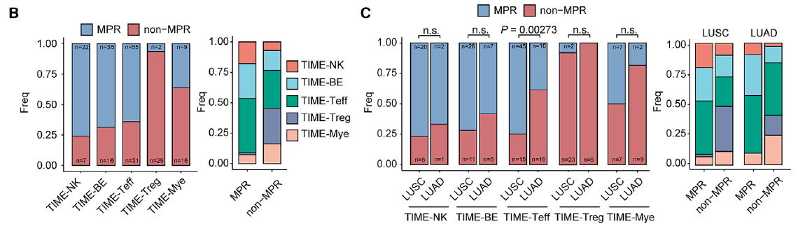
Pathological Response Across TIME Subtypes
TIME-NK and TIME-BE → high MPR / PRR
TIME-Treg → low MPR and poor response
Indicates immune composition predicts pathologic response
Notes:
Having defined the five TIME subtypes, the next question was whether these immune ecosystems are associated with how well the tumors actually responded to therapy.
When the authors compared subtypes with pathologic response outcomes measured by RVT%, a striking pattern appeared. Tumors classified as TIME-NK and TIME-BE — those rich in cytotoxic or B-cell activity — were far more likely to achieve major pathologic response (MPR), meaning they had very little viable tumor remaining after treatment. TIME-Mye showed intermediate results, while TIME-Treg, dominated by suppressive regulatory T cells, corresponded to the poorest responses.
It’s important to note that these immune profiles come from post-treatment resected tumors, not pre-treatment biopsies. So, rather than predicting response prospectively, they reflect the immune landscape that remains after therapy — a snapshot of how effectively each patient’s immune system engaged with the tumor. In that sense, the TIME subtype captures the biological outcome of therapy, revealing which immune programs are associated with success versus resistance.
These correlations form the foundation for the deeper cellular analyses that follow. To understand why some TIME structures link to strong responses, the authors next zoomed in on the most cytotoxic subtype, TIME-NK, and examined the effector T cells that drive it.

Slide 10
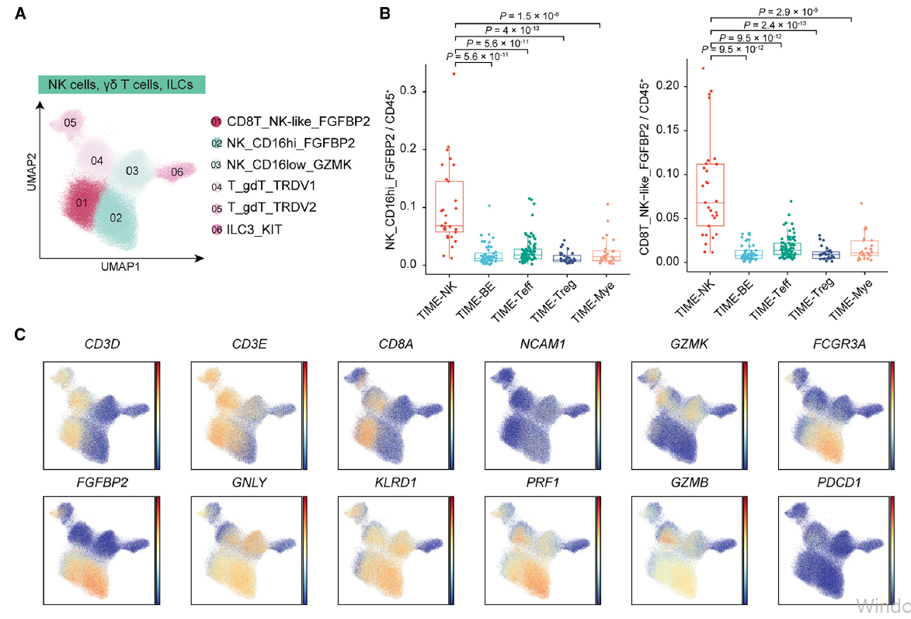
TIME-NK:FGFBP2+ NK-like CD8 T cells
NK-associated cytotoxic genes
Notes:
The TIME-NK subtype stands out as the most cytotoxic immune ecosystem within the cohort. What defines this group is the abundance of a very distinctive effector population — FGFBP2-positive CD8 T cells, also known as NK-like T cells.
These cells are fascinating because they blur the boundary between traditional T cells and natural killer cells. They carry the core CD8 T-cell identity, but at the same time, they express a suite of NK-associated cytotoxic genes such as FGFBP2, PRF1, and GZMB. This mixed transcriptional signature marks them as exceptionally potent effectors capable of releasing perforin and granzymes to directly kill tumor targets.
Functionally, they represent a specialized, non-exhausted lineage of tumor-reactive T cells. Compared with terminally exhausted T cells, these FGFBP2⁺ NK-like CD8 cells maintain higher effector activity and show minimal TCR clonal overlap — suggesting that they follow an independent differentiation path rather than being “re-energized” exhausted cells.
Clinically, tumors enriched in these NK-like CD8 T cells show the lowest residual viable tumor percentages in the entire cohort, aligning closely with major pathologic response. So, the TIME-NK subtype exemplifies an immune environment dominated by active, multifunctional killers — a blueprint of what an effective anti-tumor response looks like after PD-1 blockade. But cytotoxic attack isn’t the only successful strategy; the next subtype, TIME-BE, achieves similar outcomes through highly organized B-cell–driven immune structures.

Slide 11
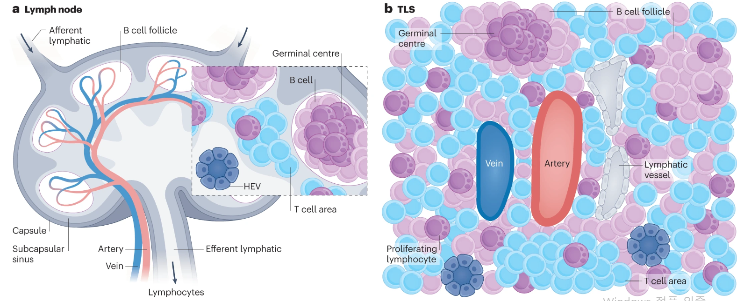
TIME-BE: B Cells and Tertiary Lymphoid Structures (TLS)
(Yuki et al., 2023)
Notes:
While the TIME-NK subtype shows how direct cytotoxicity can drive tumor clearance, the TIME-BE subtype demonstrates another path to effective anti-tumor immunity — one built on immune organization rather than pure killing.
TIME-BE tumors are highly enriched in B cells, which assemble into well-defined clusters known as Tertiary Lymphoid Structures, or TLS.

Slide 12
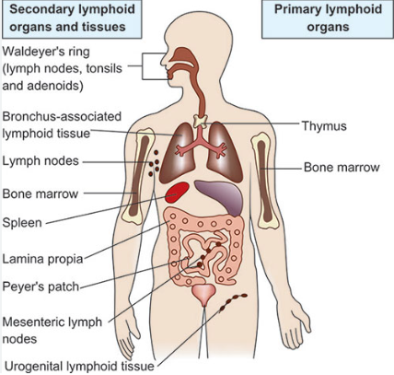
TIME-BE: B Cells and Tertiary Lymphoid Structures (TLS)
Primary lymphoid organs — thymus and bone marrow, where lymphocytes develop.
Secondary lymphoid organs — lymph nodes and spleen, where immune cells activate and interact.
Tertiary lymphoid structures (TLS) — ectopic, formed in tissues like tumors under chronic inflammation.
Notes:
To appreciate why this is important, it helps to recall the logic of our immune system’s architecture:
Primary lymphoid organs like the bone marrow and thymus are where immune cells are generated,
and secondary lymphoid organs such as lymph nodes and the spleen are where they encounter antigens and become activated.
TLSs essentially recreate this architecture inside the tumor, functioning as miniature, in-situ lymph nodes where B cells, T cells, and dendritic cells coordinate antigen presentation and activation.

Slide 13
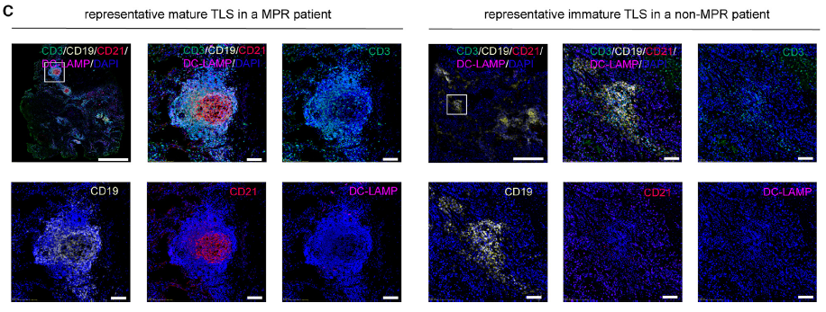
TIME-BE: B Cells and Tertiary Lymphoid Structures (TLS)
B cell aggregation!
Notes:
To determine whether these TLSs were mature or immature, the authors performed multiplexed immunofluorescence (mIF) staining. Using markers CD21 and DC-LAMP, they could distinguish TLS maturity: clusters that were CD21⁺ and DC-LAMP⁺ corresponded to mature TLSs, indicating the presence of follicular dendritic cells and active antigen presentation, whereas CD21⁻ DC-LAMP⁻ B-cell aggregates represented immature TLSs, lacking this organized germinal-center-like structure.
The distinction was clinically meaningful. In MPR patients, tumors frequently contained mature TLSs, while non-MPR tumors mostly showed immature TLSs. This demonstrates that not only the presence but also the maturation state of TLSs correlates strongly with treatment success — mature TLSs support ongoing local activation, whereas immature ones remain ineffective.
Consequently, TIME-BE tumors with mature TLSs exhibit higher pathologic response rates and better recurrence-free survival. It’s also interesting that TLSs can play opposite roles in different contexts — driving autoimmunity in diseases like rheumatoid arthritis, yet promoting tumor control when formed inside cancers.
In short, TIME-BE represents immune success through structured coordination. Together with the cytotoxic TIME-NK subtype, it defines the “active” pole of the tumor-immune spectrum — and next, we’ll explore the opposite extreme, the TIME-Treg subtype, where immune suppression dominates.

Slide 14
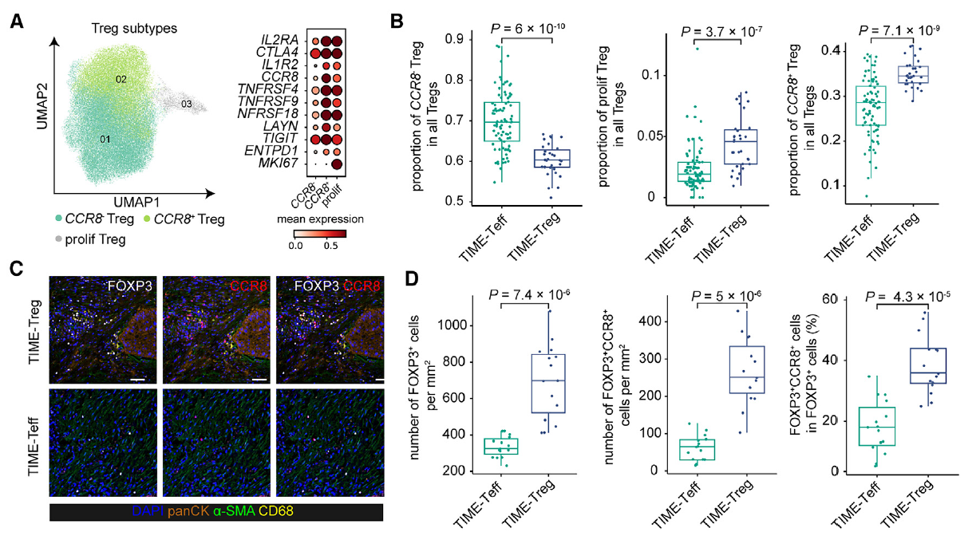
TIME-Teff vs TIME-Treg
Immunosuppression
Notes:
While TIME-NK and TIME-BE represent immune-active environments that support anti-tumor response, not all immune infiltration is beneficial. The TIME-Treg subtype exemplifies a tumor microenvironment dominated by regulatory T cells, or Tregs, which suppress rather than stimulate immunity.
The authors first noticed that patients within the TIME-Treg subtype showed a strong negative correlation between Treg enrichment and MPR rate, meaning that the more Tregs a tumor contained, the worse its pathologic response. To explore this further, they dissected the heterogeneity of Tregs at single-cell resolution and identified three major Treg subtypes (Figure 5A): proliferating Tregs, CCR8– Tregs, and CCR8⁺ Tregs.
Among these, CCR8⁺ Tregs expressed the highest levels of FOXP3, IL2RA, and CTLA4, as well as TNFRSF4 and TNFRSF18 — markers associated with strong suppressive activity. This profile closely matches CCR8⁺ Tregs previously reported in lung cancer and suggests that they represent the most immunosuppressive Treg subset in this context.
When comparing across TIME subtypes, the distinction was clear (Figure 5B): TIME-Teff tumors contained more CCR8– Tregs, which are relatively less suppressive, while TIME-Treg tumors had higher proportions of both CCR8⁺ Tregs and proliferating Tregs, indicating an expanded, highly active regulatory compartment.
These findings were confirmed by multiplexed immunofluorescence (mIF) staining of tumor samples (Figures 5C and 5D). Patients with TIME-Treg showed a markedly increased number and proportion of FOXP3⁺CCR8⁺ cells within total Tregs, confirming the dominance of this highly suppressive subset in their tumors.
Together, these results reveal that not all Tregs are equal — TIME-Teff and TIME-Treg harbor distinct Treg subpopulations with different suppressive capacities. The enrichment of CCR8⁺ FOXP3⁺ Tregs in TIME-Treg tumors likely explains their poor MPR rates and reduced recurrence-free survival. This contrast between effector-dominant and Treg-dominant microenvironments sets the stage for the next analysis — exploring how these immune states shape T-cell differentiation and exhaustion trajectories.

Slide 15
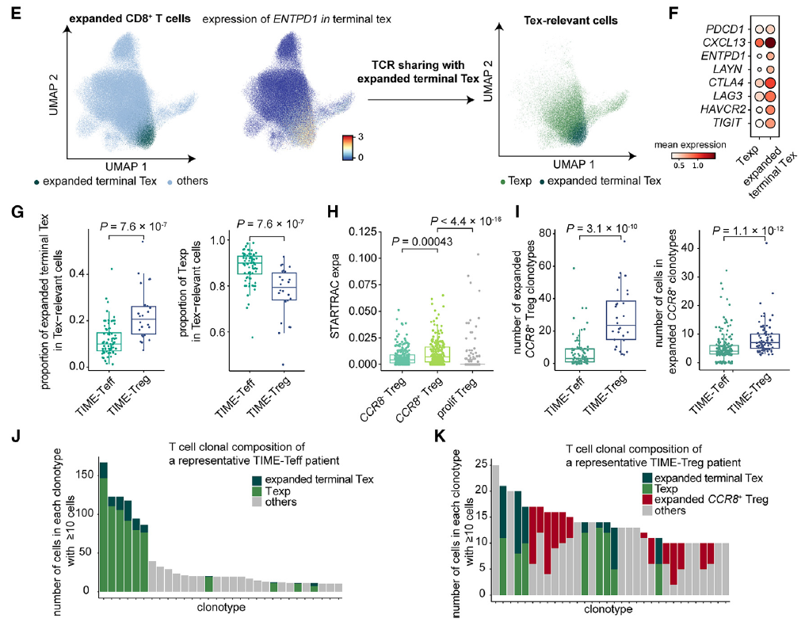
TIME-Teff vs TIME-Treg
Texp vs Tex
Texp cells remain functional
Tex cells are terminally exhausted.
TIME Teff vs TIME Treg
TIME-Teff favors Texp expansion TIME-Treg favors Tex dominance.
Effector maintenance versus exhaustion drives response outcomes.
Notes:
Having identified the cellular composition of TIME-Treg tumors, the authors next investigated how T-cell clonal expansion differs between TIME-Teff and TIME-Treg patients. To do this, they used single-cell TCR-sequencing (scTCR-seq) data from 214 patients to trace how individual T-cell clones expand within each immune context.
They first focused on CD8⁺ T cells and defined clonally expanded clones as those containing at least three cells with the same TCR sequence. Among these, they identified a subset of tumor-antigen-specific clones, which they called Tex-relevant cells (Figure 5E). This group includes both terminally exhausted Tex cells and their precursor exhausted Texp cells that share identical TCRs but differ in transcriptional state.
In other words, Texp cells are younger siblings of Tex cells — still functional, expressing GZMK and IL7R, but not yet expressing high levels of checkpoint genes such as PDCD1, and LAG3 like exhausted T cells. By contrast, Tex cells represent the terminally differentiated, antigen-specific exhausted T cells that have lost their effector function.
When comparing patients (Figures 5G–K), TIME-Teff tumors contained a higher proportion of Texp cells among total Tex-relevant cells, whereas TIME-Treg tumors showed a greater fraction of terminally exhausted Tex cells, consistent with accelerated exhaustion in suppressive environments. These differences align with therapeutic outcome: patients enriched in Texp cells tended to achieve higher MPR rates, while those with more terminally exhausted Tex cells showed lower MPR rates and poor RFS.
In addition, the authors also analyzed CCR8⁺ Treg clonal expansion (Fig. 5H–I). Expanded CCR8⁺ Tregs — defined as clones with at least three cells per TCR — were more numerous and more clonally expanded in TIME-Treg than in TIME-Teff tumors. This parallel expansion of both terminally exhausted CD8 T cells and suppressive CCR8⁺ Tregs provides a mechanistic explanation for the low response rates in TIME-Treg patients.
Altogether, these data reveal that distinct immune-cell expansion programs like precursor exhausted Texp growth in TIME-Teff versus terminally exhausted Tex and Treg expansion in TIME-Treg — directly correspond to their contrasting pathologic response rates.
Building on this, the authors next compared these expansion patterns across all MPR and non-MPR patients, to determine whether immune heterogeneity persists even among those who fail to achieve MPR.

Slide 16
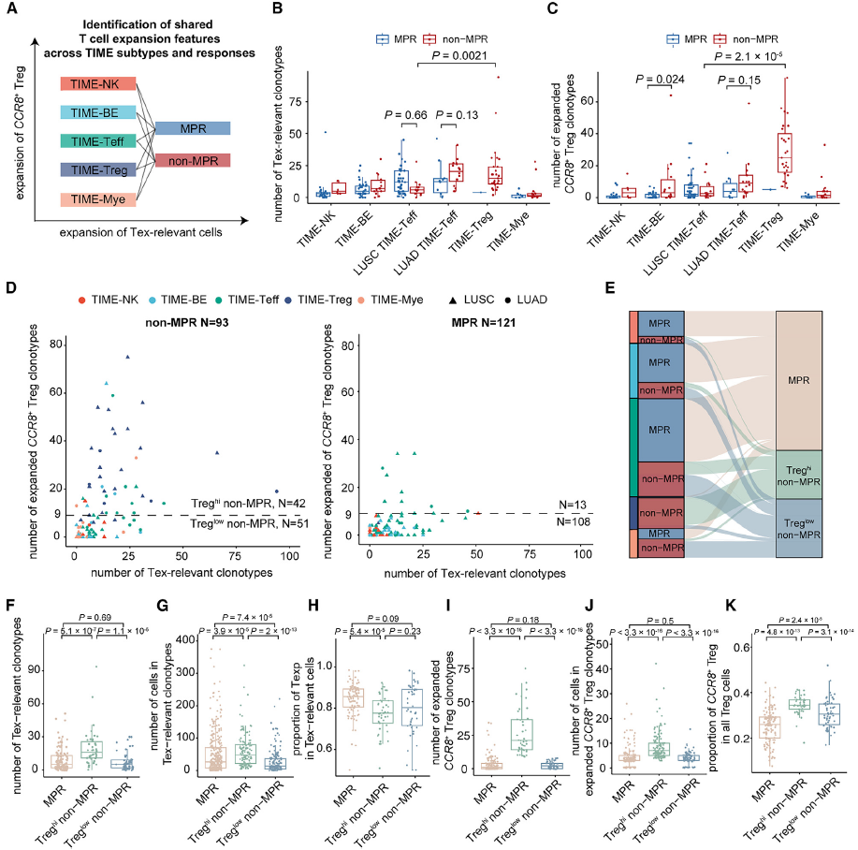
TCR Clonotype & Non-MPR Heterogeneity
Non-MPR patients split into Treg hi and Treg low groups.
Treg hi tumors: expanded CCR8⁺ Tregs, few Texp cells.
Treg hi non-MPR
Treg low non-MPR
Notes:
Given the crucial role of T cells in immunotherapy response, the authors next examined how T-cell and Treg clonal expansion patterns vary across patients who did and did not achieve MPR (Figure 6A). The goal was to understand whether all non-responders share the same immune defect, or if there are distinct immune signatures even among non-MPR patients.
The analysis began with Tex-relevant CD8⁺ T cells and expanded CCR8⁺ Tregs (Figures 6B and 6C). Patients with TIME-Treg tumors showed the highest numbers of both Tex-relevant clonotypes and expanded CCR8⁺ Treg clonotypes — indicating that these tumors contain numerous antigen-specific T cell clones but also strong regulatory expansion that likely suppresses their activity.
To systematically compare non-MPR patients, the authors ranked all patients by the number of expanded CCR8⁺ Treg clonotypes and defined the top quartile (R9) as Treg^hi non-MPR patients and the rest as Treg^low non-MPR patients (Figure 6D). In total, they identified 42 Treg^hi and 51 Treg^low non-MPR patients. On average, Treg^hi patients had ~21 expanded CCR8⁺ Treg clonotypes, compared with only 1–2 clonotypes in MPR and Treg^low non-MPR patients. Interestingly, these Treg^hi non-MPR cases were not limited to the TIME-Treg group — they appeared across all five TIME subtypes (Figure 6E), highlighting that high Treg expansion is a pan-subtype phenomenon.
Functionally, these two non-MPR groups showed distinct T-cell profiles (Figures 6F–K). Treg^hi non-MPR patients had the highest number of Tex-relevant clonotypes but the lowest proportion of Texp cells within that pool, indicating that most antigen-specific T cells had already transitioned to terminal exhaustion. They also showed marked CCR8⁺ Treg clonal expansion, which likely reinforces this suppression. In contrast, Treg^low non-MPR patients resembled MPR responders — they had similar numbers of Tex-relevant clonotypes but somewhat reduced expansion and moderately higher CCR8⁺ Treg proportions.
Together, these results demonstrate that non-MPR patients are not immunologically homogeneous. Some fail therapy because of dominant Treg expansion and T-cell exhaustion like Treg^hi non-MPR case, while others retain a more balanced immune landscape like Treg^low non-MPR patients but still show reduced T cell expansion compared to responders. This heterogeneity suggests that multiple immune failure modes can lead to non-response to PD-1 blockade. With this stratification established, the next analysis examined how these immune variables such as cytotoxic activity, T-cell exhaustion, and Treg abundance — relate quantitatively to recurrence-free survival using Cox regression.

Slide 17
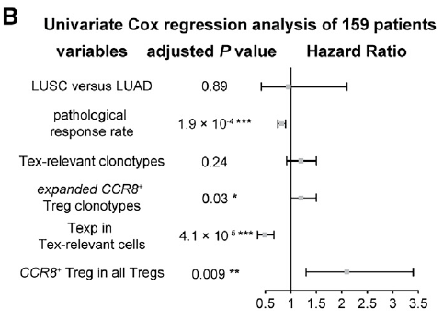
Cox Proportional-Hazard Analysis
Used to identify factors that influence recurrence risk over time
Models time-to-event data (e.g., time to recurrence)
Estimates Hazard Ratio (HR) for each variable → HR < 1: lower recurrence risk → HR > 1: higher recurrence risk
Notes:
Before diving into the survival results, I’ll briefly explain what Cox proportional-hazard analysis is.
It’s a model that estimates how much each variable affects recurrence risk over time.
The output is a hazard ratio that values below 1 indicate protection, while values above 1 indicate higher risk.
So when we see a hazard ratio of 0.5 for Texp in this figure, that means higher Texp fractions cut recurrence risk by about half.

Slide 18
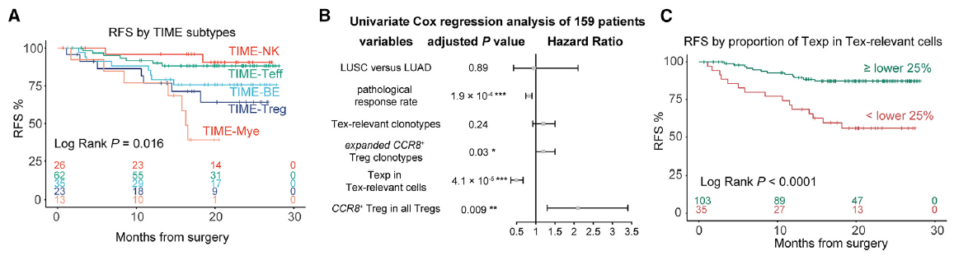
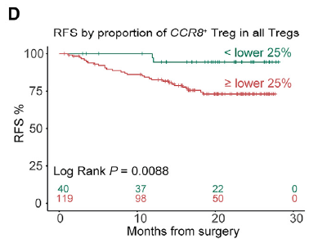
Recurrence-Free Survival (Cox-PH Analysis)
TIME-NK/Teff have best RFS
TIME-Treg/Mye relapse earlier
More Texp → lower recurrence risk; more CCR8⁺ Tregs → higher risk
Notes:
So now that we understand what a Cox proportional-hazard analysis does —
essentially quantifying how each immune or clinical variable affects recurrence risk over time —
let’s look at how the authors actually applied this model to their NSCLC patient cohort.
Although neoadjuvant immunotherapy has significantly improved outcomes for patients with locally advanced NSCLC, a subset of patients still experience disease recurrence after surgery — especially those who fail to achieve major pathologic response (MPR). To identify immune features associated with recurrence-free survival (RFS), the authors analyzed data from 159 of the 222 patients, with a median follow-up of about 19 months (Figure 7A).
When comparing RFS across the five TIME subtypes, a clear pattern emerged: TIME-NK and TIME-Teff patients — both characterized by cytotoxic and effector activity — showed the lowest recurrence risk. In contrast, TIME-Treg and TIME-Mye patients exhibited shorter RFS, consistent with their immunosuppressive profiles. This suggests that the same immune architectures that determine pathologic response also influence long-term clinical outcome.
To quantify these effects, the authors performed a univariate Cox proportional-hazard (Cox-ph) analysis on both clinical and immune parameters (Figure 7B). Among clinical variables, the pathologic response rate (PRR) was strongly associated with better RFS — confirming that deeper tumor regression translates to longer remission. Interestingly, histological subtype (LUAD vs LUSC) did not significantly change recurrence risk once immune context was considered.
Among immune-cell features, several stood out. First, the number of expanded CCR8⁺ Treg clonotypes was significantly correlated with increased recurrence risk, while the number of Tex-relevant clonotypes was not (Figure 7B). In fact, patients in the top quartile for CCR8⁺ Treg expansion had notably poorer RFS, emphasizing the prognostic weight of regulatory T-cell dominance.
Conversely, the proportion of Texp cells within Tex-relevant cells emerged as the strongest protective factor for recurrence. In the same way, a higher fraction of CCR8⁺ Tregs among total Tregs independently predicted shorter RFS (Figure 7D).
Together, these results show that cytotoxic competence and regulatory suppression act as opposing forces shaping long-term survival: expansion of precursor exhausted Texp cells protects against relapse, whereas clonal proliferation of CCR8⁺ Tregs increases recurrence risk. In short, the immune architecture seen at resection — not just tumor regression — carries lasting prognostic value after neoadjuvant PD-1 blockade.

Slide 19
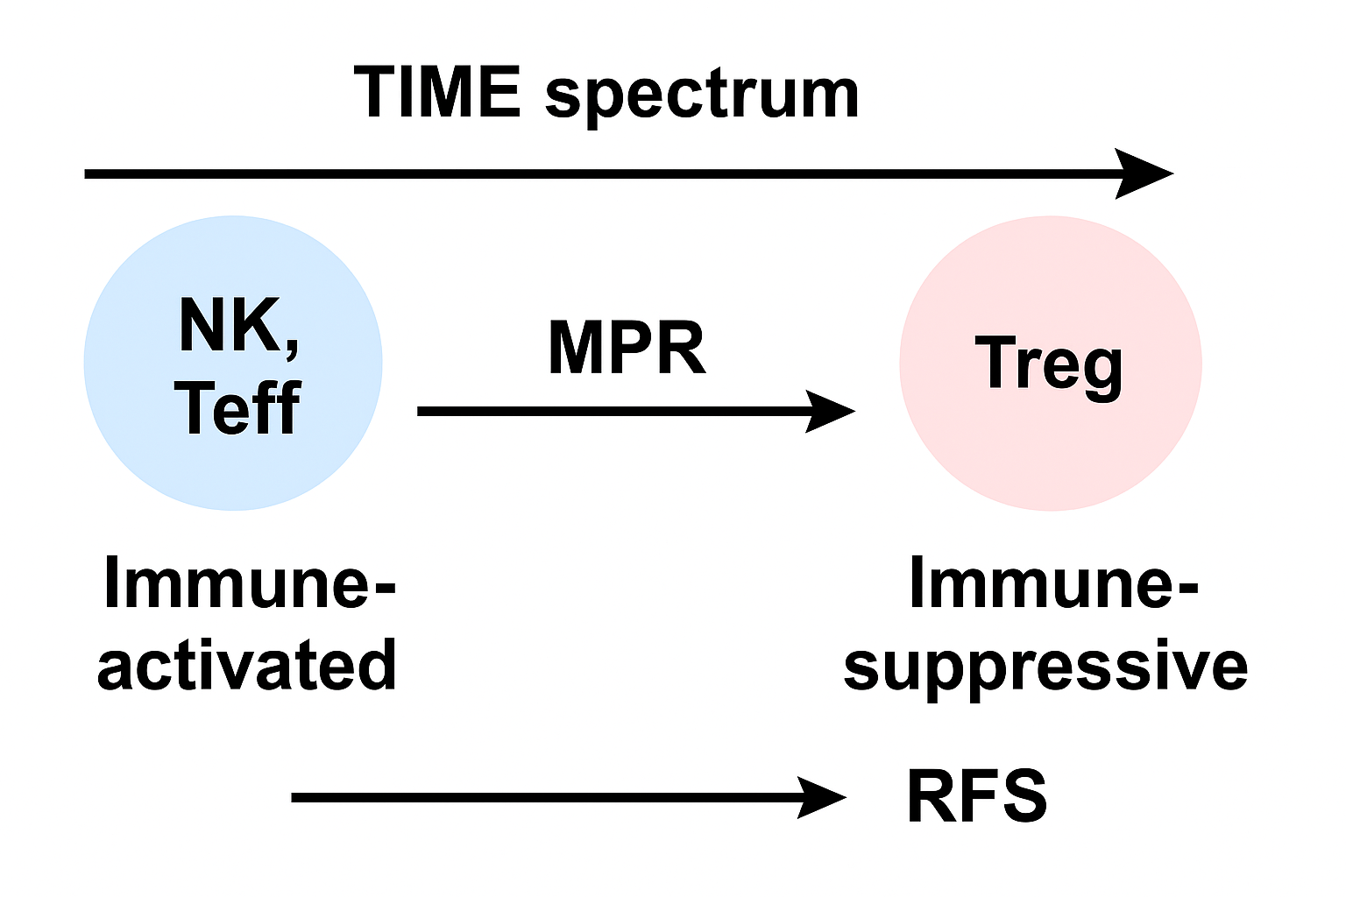
Integrated Model and Clinical Implications
-Cytotoxic and effector T cells
-Mature TLS
-High Texp cells
-High MPR, RFS
-Tregs and exhausted T cells
-Immature TLS
-Shorter RFS
Notes:
All of these findings come together into a unified conceptual model that links the tumor immune microenvironment (TIME) to both pathologic response and long-term recurrence outcomes.
On the left side of this spectrum are the immune-activated subtypes — TIME-NK and TIME-Teff. These tumors are dominated by cytotoxic and effector T cells, and in many cases, mature TLS formation. They maintain a high proportion of Texp cells, reflecting active and effective anti-tumor immunity. As a result, they achieve major pathologic responses (MPR) after PD-1 blockade and exhibit prolonged recurrence-free survival (RFS) after surgery.
On the opposite end lie the immune-suppressive subtypes, such as TIME-Treg and TIME-Mye. These are characterized by expanded CCR8⁺ FOXP3⁺ Tregs, terminally exhausted CD8⁺ T cells, and lack of TLS maturation. Such tumors rarely reach MPR and tend to relapse earlier, resulting in shorter RFS. In these cases, the immune response is not absent — it’s actively suppressed and diverted into a dysfunctional state.
In essence, this study defines a continuum — or “TIME spectrum” — where the immune landscape transitions from activation to suppression. The position of each patient along this axis determines both their initial therapeutic response (MPR) and long-term recurrence risk (RFS).
This integrated model has important clinical implications:
It suggests that profiling the tumor immune composition before treatment could help predict which patients are most likely to benefit from PD-1 blockade.
It also highlights potential targetable resistance mechanisms — for instance, blocking CCR8⁺ Tregs or restoring effector T-cell function could improve responses in immunosuppressive TIME contexts.
Ultimately, this study shows that the tumor microenvironment is not a static feature but a dynamic spectrum of immune states — and understanding where a patient’s tumor lies on this spectrum may guide more personalized immunotherapy strategies.

Slide 20
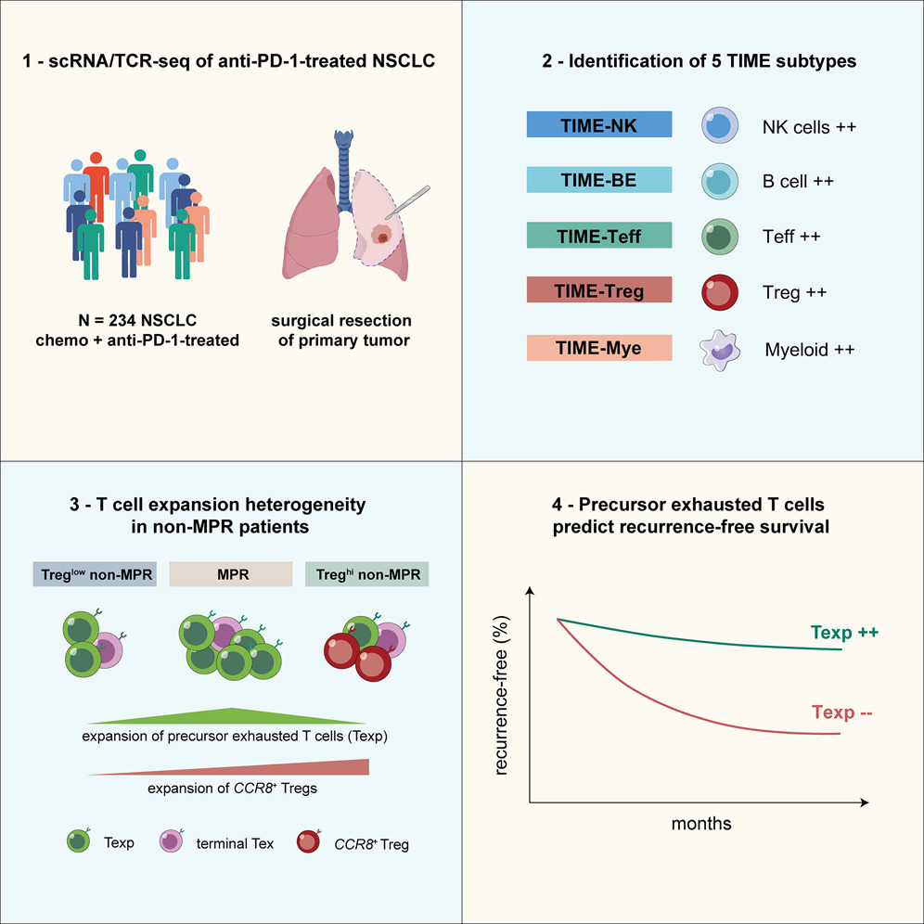
Summary and Take-Home Messages
The power of cohort-level single-cell analysis
The TIME exists on a functional spectrum
Distinct immune programs drive success or failure
Clinical implication
Notes:
Alright, to wrap up — let’s take a step back and summarize what this study really tells us.
The first key message is about the power of cohort-level single-cell analysis. Rather than looking at just a few samples or one tumor type, this study analyzed over 200 NSCLC patients using both scRNA-seq and scTCR-seq data. By integrating molecular data with clinical outcomes, the authors could see that the variability between patients — what we often call “noise” — actually carries crucial biological meaning. It’s this inter-patient diversity that reveals how different immune ecosystems drive distinct therapeutic outcomes.
The second message is that the tumor immune microenvironment, or TIME, exists on a continuous functional spectrum. On one end, we have immune-activated subtypes like TIME-NK and TIME-Teff, where cytotoxic T and NK cells dominate, leading to strong responses and durable remission. On the other end, we see immunosuppressive subtypes like TIME-Treg and TIME-Mye, marked by high CCR8⁺ Tregs and terminally exhausted T cells, which correlate with poor MPR and shorter RFS. So the TIME isn’t just a binary “hot” or “cold” state — it’s a spectrum that fundamentally determines both short- and long-term therapy outcomes.
Third, this study shows that distinct immune programs drive success or failure. Expansion of effector-like Texp cells was a hallmark of patients who achieved sustained remission, whereas expansion of CCR8⁺ FOXP3⁺ Tregs defined those who relapsed despite PD-1 blockade. These signatures are not just descriptive — they can serve as measurable biomarkers and even therapeutic targets. For example, targeting CCR8⁺ Tregs could be a strategy to overcome immune suppression in resistant tumors.
Finally, the clinical implication is clear: by profiling a patient’s TIME composition before therapy, we may be able to predict who will respond to PD-1 blockade and who won’t. This moves us closer to truly personalized immunotherapy, where treatment is guided by the immune architecture of each tumor.
So in short, this study bridges the cellular and the clinical — showing how single-cell immunology can inform patient-level prediction, prognosis, and ultimately, therapeutic design.

Slide 21


Slide 22
Outline
Cohorts
What are cohorts?
Why cohorts?
Atlas Study (Liu et al.)
MrVI (Boyeau et al.)
scVI Recap
Challenges in scVI
MrVI: An intuition
Case studies

Slide 23
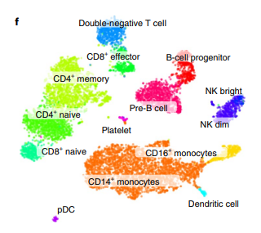
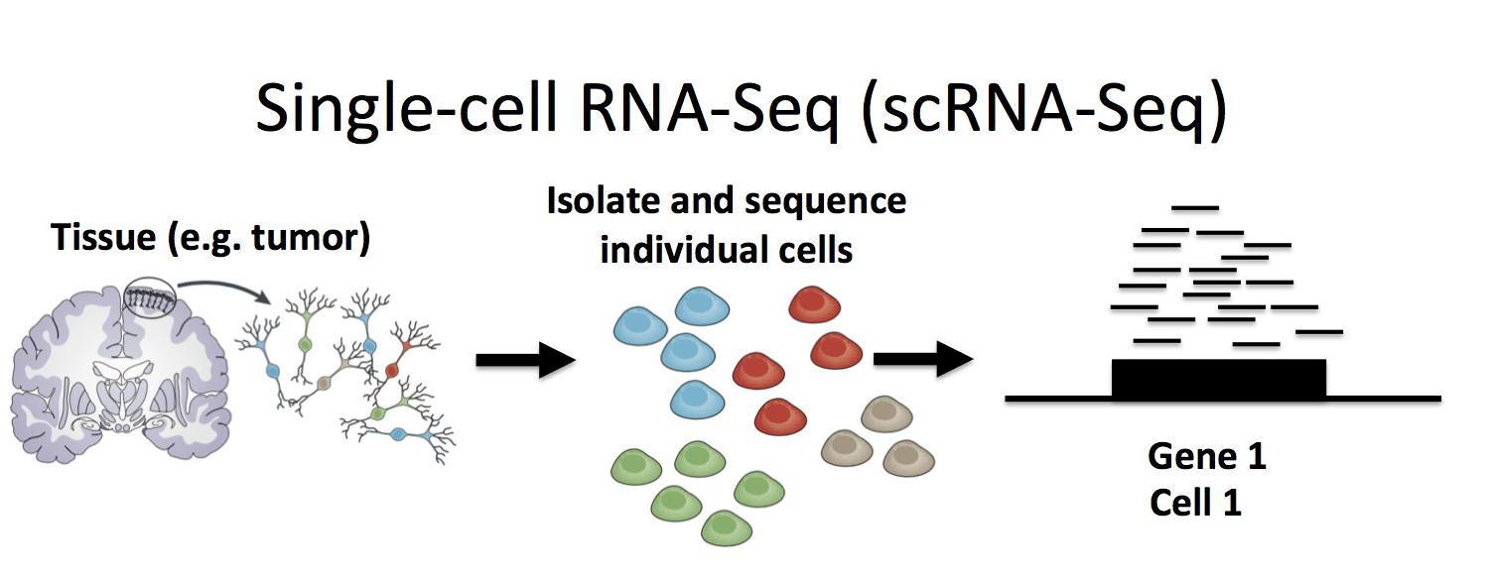
Recap: sc-RNA Seq allows analyzing mechanism of disease at much detailed resolution
f, A t-SNE embedding of a primary peripheral blood mononuclear cell (PBMC) dataset with cell annotations. NK, natural killer, separated into CD56 bright and dim subsets. pDC, plasmacytoid dendritic cell
Kharchenko, Peter V. "The triumphs and limitations of computational methods for scRNA-seq." Nature methods 18.7 (2021): 723-732.
Notes:
Recap:
Bulk ->
Single Cell

Slide 24
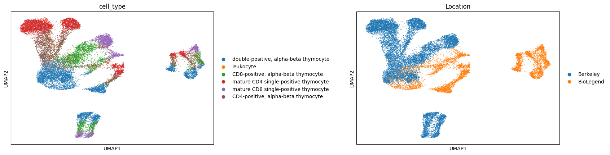
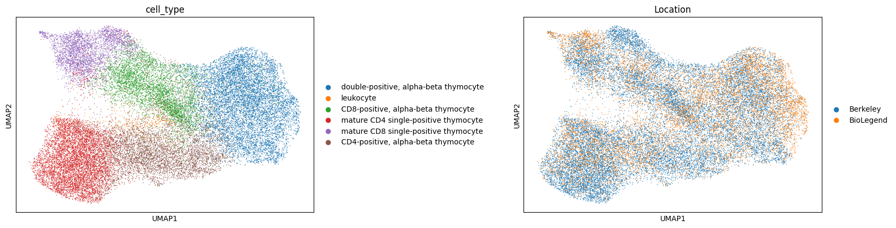
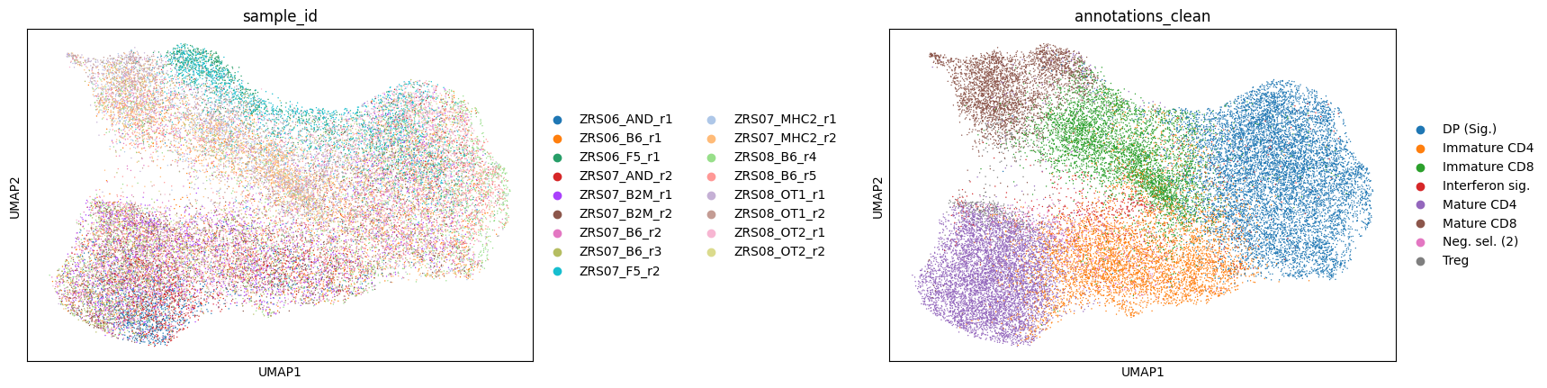
scVI provided a scalable framework for the probabilistic representation and analysis of single cell
Done? but… sample level heterogeneity?

Slide 25
Smoothies Again? Within Sample
Single Cell:
individual ingredients (cells) and not the smoothie (average/bulk analysis)
PCA or even scVI:
Latent Space, and possibly cell-level classification
However, subtle differences inside the same cell classification are completely ignored, in other words, “smoothied” again
“assumes the effects they evaluate are constant”

Slide 26
Outline
Cohorts
What are cohorts?
Why cohorts?
Atlas Study (Liu et al.)
MrVI (Boyeau et al.)
scVI Recap
Challenges in scVI
MrVI: An intuition
Case studies

Slide 27
Motivation of MrVI for Cohort Studies
Contribution:
stratifying samples into groups (HOW)
evaluating the cellular and molecular differences between groups (WHY)
Separate biological signal (target covariate) | technical noise (nuisance covariate)
without requiring a priori grouping of cells into types or states.

Slide 28
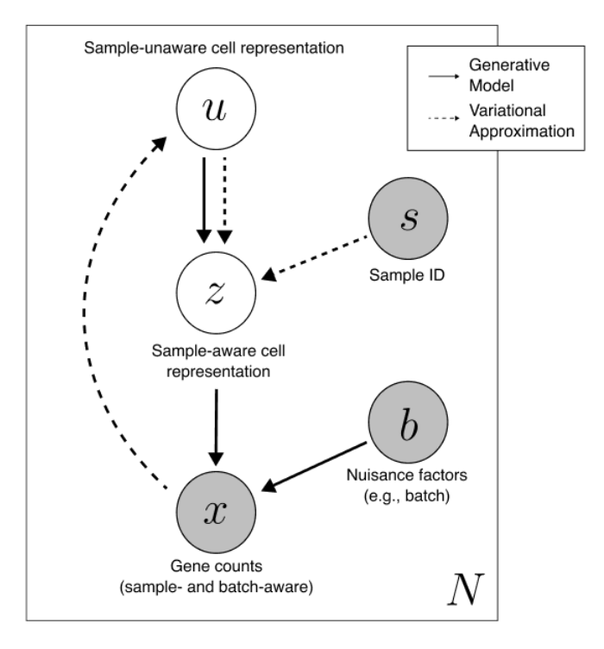
The Diagram (you’ll get sick of this…)
most pure
“Pure” state without any covariates
Now with covariates that we care about!
Original Data
(ft. batch effects)
most noise

Slide 29
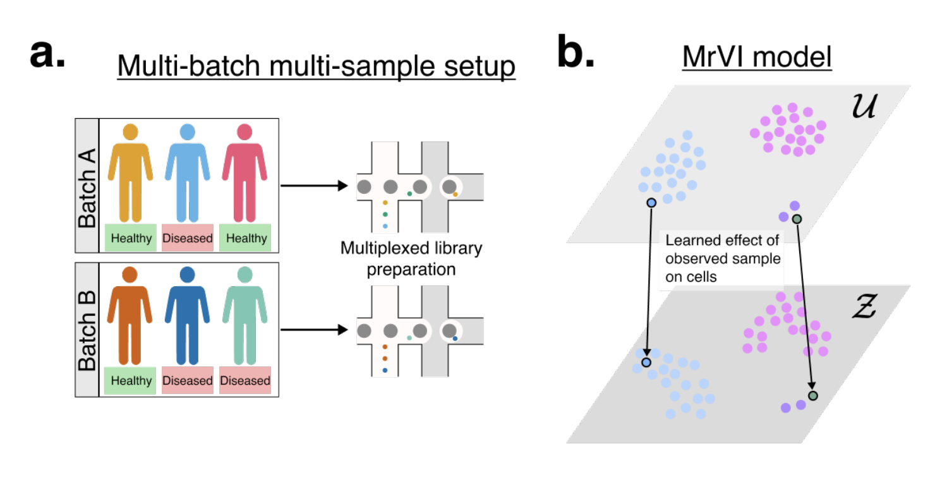
mrVI, What Can You Do? (1/3)
(For simplicity, we assume dim(u-space) = dim(z-space))
Notes:
Multiplexed library preparation is a technique that involves pooling multiple samples and adding unique sample indexes (barcodes) during the library preparation process to allow them to be sequenced together in a single run
Multiplexed library preparation is a technique in genomics that allows multiple different samples (like DNA or RNA from different individuals) to be combined and sequenced together in a single run

Slide 30
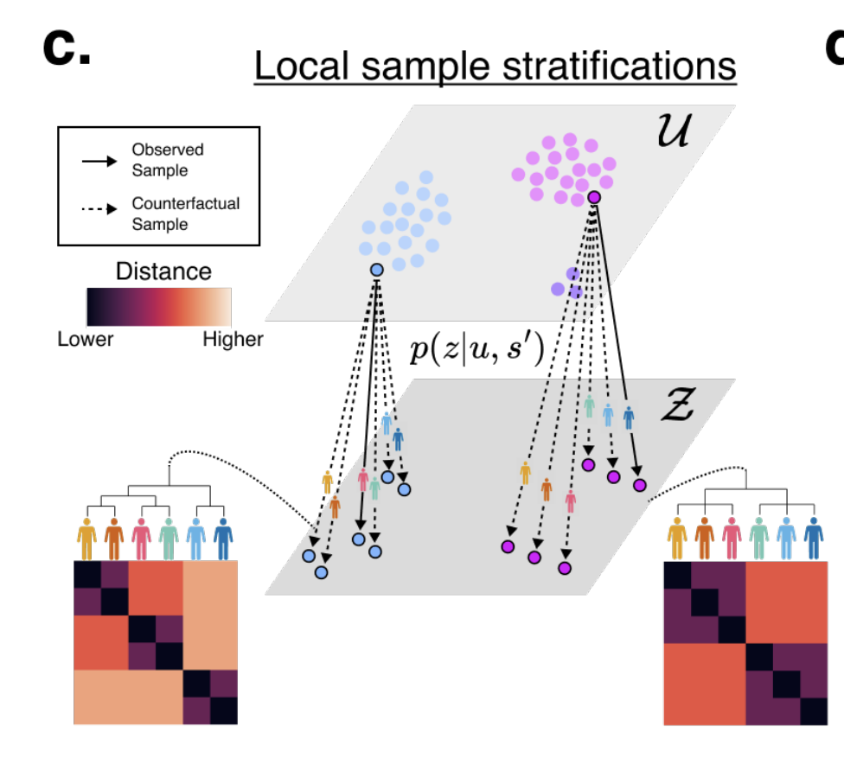

mrVI, What Can You Do? (2/3)
“Multiverse!”

Slide 31
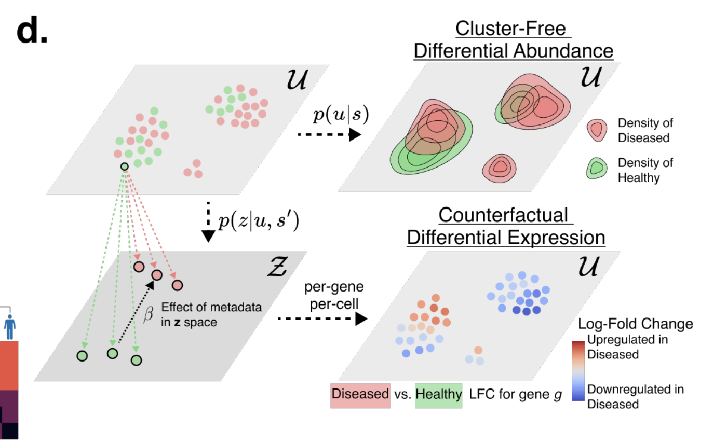
mrVI, What Can You Do? (3/3)
Will explain this in detail later…

Slide 32
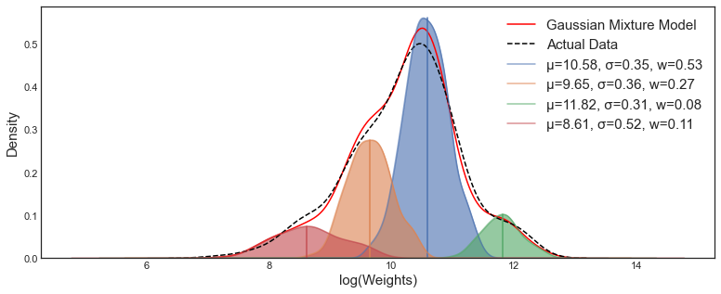
Mixture of Gaussians (very lightly)
sampling with weighted combination of Gaussians
Possibly account for distinct clusters for different cell types or states

Slide 33
The Diagram, but with a “VAE lens”
Then we try to “decode”
(or “reconstruct”)
This is the “encoder”

Slide 34
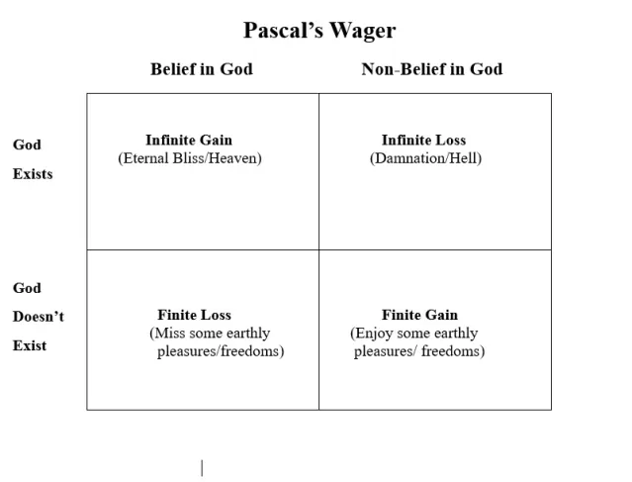
A Piece of Philosophy
The efficacy of mrVI greatly hinges upon the existence of a u-space that nicely captures the essence of our dataset, in addition to the z-space
If you believe in Nature…
 | Belief in u-space | Non-belief in u-space
U-space exists | Infinite Gain (Nature paper) | Infinite Loss (Somebody else writes a Nature paper)
U-space doesn’t exist | Finite Loss (Experiment fails) | Finite Gain (Do something else)

Slide 35
A Bad Analogy (maybe not)
U-space asks: What are you? (What is this cell?)
Z-space asks: What are you? And How are you?
(How does this cell behave?)
Which leads us to believe that the How is encoded in (Z - U)…?!

Slide 36
Kind of a “Proof”
What we care about: Arrows!
Or in biology terms: Sample effects!!
Or kind of a “(Z - U)” effect!!!
u-space
z-space
(with counterfactuals)
z-space (scVI)

Slide 37
mrVI, What Can You Do? (2/3), again
“Multiverse!”

Slide 38
New Challenge, Under the Rug
What ensures that these two green arrows will be the same?
“Well… better train it good” or “No Free Lunch”
We turned one hard problem into another hard problem!

Slide 39
A Bit of Math Ahead…

Slide 40
“Fitting a straight line can get you very far”
Sun Tzu, probably

Slide 41
How do we “measure” effects of covariates?
Counterfactuals
A_1
A_2
A
Covariate 1
Covariate 2
Intuition: slope is like the “sensitivity” of that covariate; little changes are significant

Slide 42
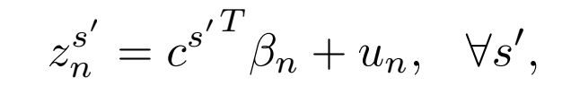
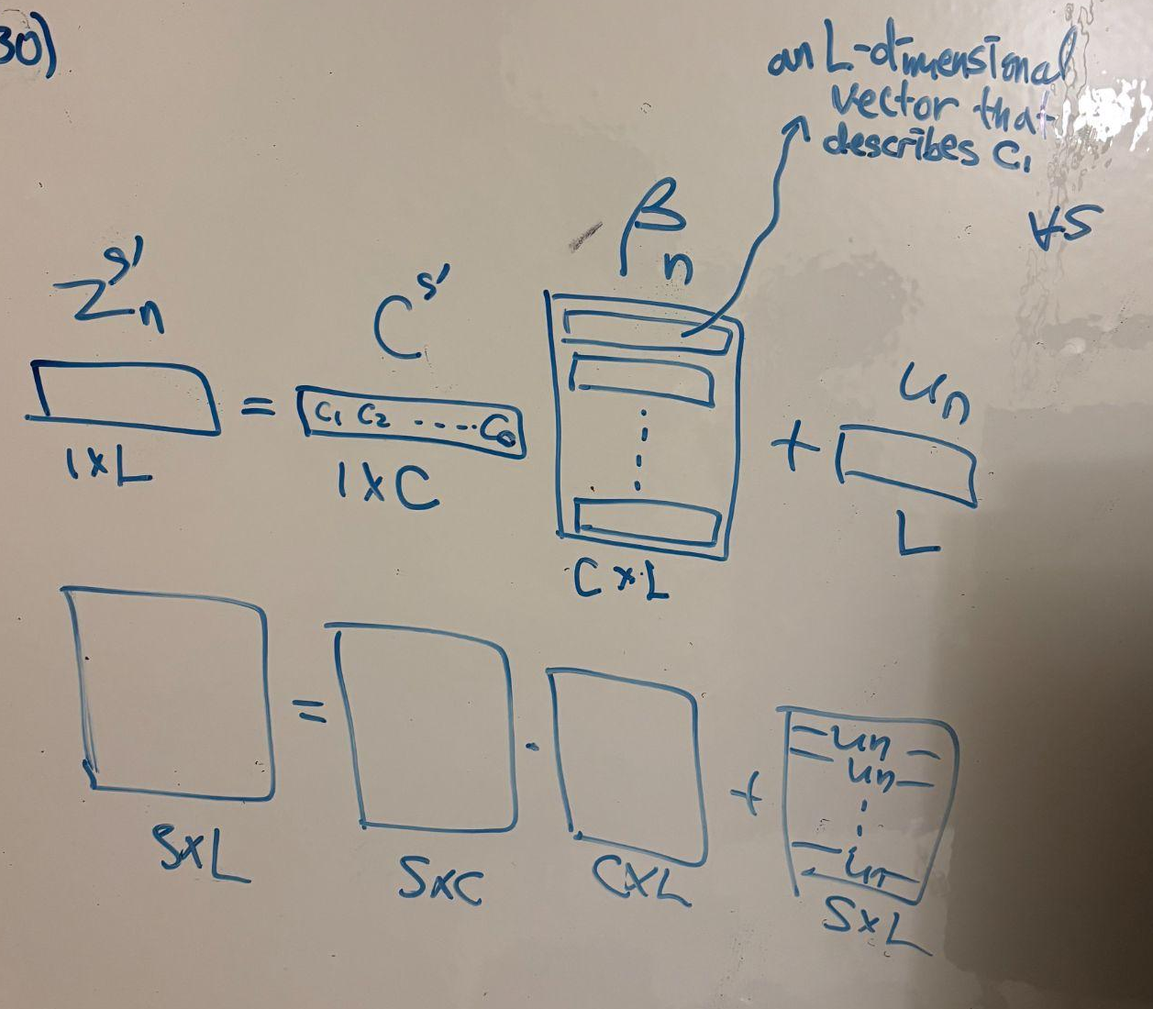
Now in HD!
(high dimensions)
Each row of Beta_n is the “representation” of each covariate in z-space
We simply fit Beta_n over all counterfactual samples of z
Beta_n[i] is now the “program” of the i-th covariate, or its
“coefficients” (actually a vector)
Digression: PCA is one way?
Intuition: weighted sum of rows of Beta.

Slide 43
“What” are you?
“How” are you?
“Computational”
“Why” are you?
“Biology”

Slide 45
mrVI, What Can You Do? (3/3), again

Slide 46
Differential Expression!!!
We might be tempted to interpret Beta as differential expression. However, Beta cannot be interpreted as differential expression since it still lives in z(^c)-space.
Still, with the two counterfactual latent points, we can generate plausible x vectors (gene counts)!
We can argue that we have eliminated unwanted batch effects that vary across subjects (because I’m comparing with myself)
(Assume a single binary covariate, a switch)

Slide 47
mrVI, What Can You Do? (3/3), again, again

Slide 48
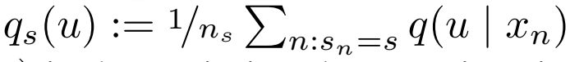
Differential Abundance??? (1/3)
Remember, U-space asks: What are you? (What is this cell?)
Woah… woah… woah… Let’s unpack.
“aggregated posterior distribution”
How likely is it for the cells from subject s to land onto exactly u?
u is just some cell state in u-space
s is just some subject
n are cells from that subject

Slide 49
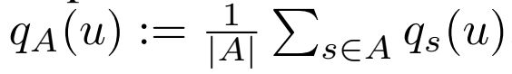
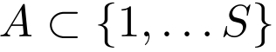
Differential Abundance??? (2/3)
“aggregated posterior distribution”
How likely is it for the cells from sample s to land onto exactly u?
This just averages that over the set of interested subjects

Slide 50
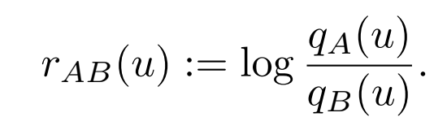
Differential Abundance??? (3/3)
“aggregated posterior distribution”
How likely is it for the cells from sample s to land onto exactly u?
This just averages that over the set of interested subjects
“log density ratio”
High (+) -> very likely to be in A
Low (-) -> very likely to be in B
(remember: log(1) = 0)

Slide 51
Why go through all of this fuss?
We get a “gradient” of membership property instead of a sharp classification
We can argue on u-space, which does not involve neither sample nor batch effects a priori
We can analyze between subsets of subjects, not the entire set of them
“Ditching z”?
Food for Thought: are we “ditching” z?

Slide 52
Outline
Cohorts
What are cohorts?
Why cohorts?
Atlas Study (Liu et al.)
MrVI (Boyeau et al.)
scVI Recap
Challenges in scVI
MrVI: An intuition
Case studies

Slide 53
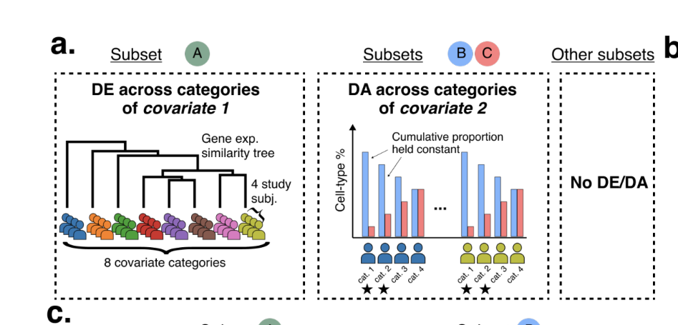
Semi-Synthesis Dataset

Slide 54
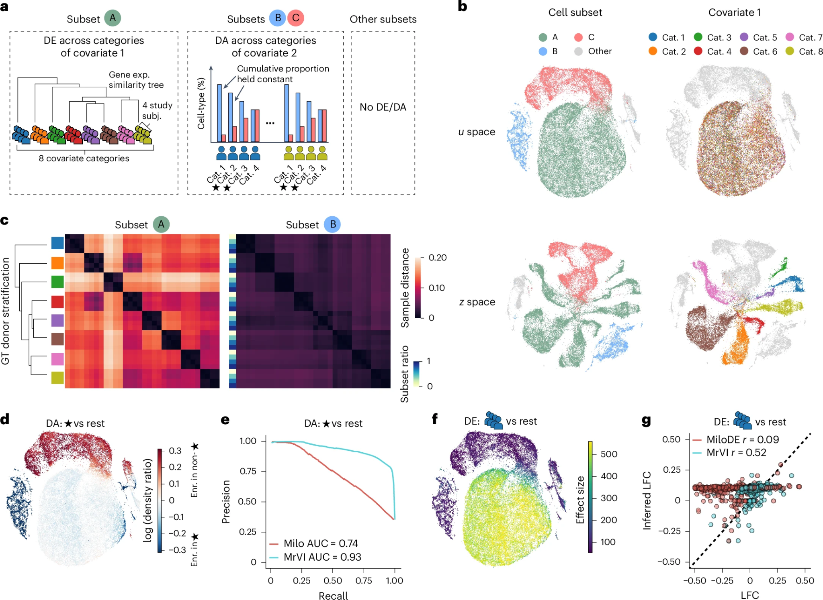

Slide 55
Fragments into subject-specific sub-clusters (colored by covariate 1)
U -> Z
inter-mixed

Slide 56
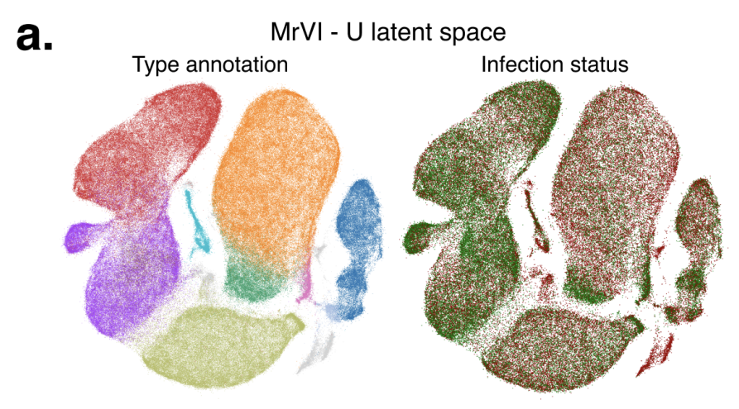
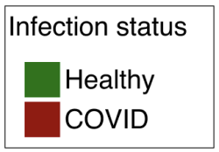
COVID Case Study (1): Grouping / Stratification
Question: Why is this the mixing of infection status important in u-space?
Question 2: What can we say about the training if they are not mixed?

Slide 57
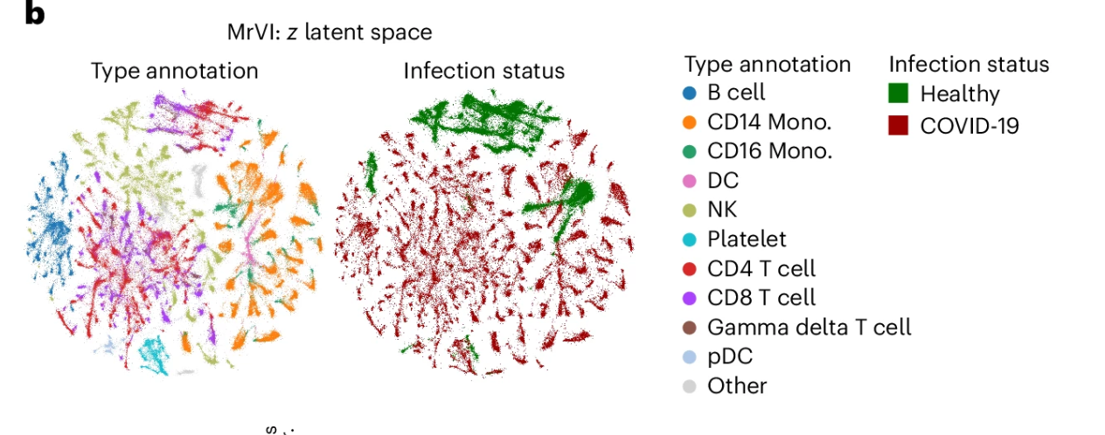
COVID Case Study (1): Grouping / Stratification

Slide 58
Case Study (2): MrVI enables grouping and characterization of small molecules in screening assays
sci-Plex: high-throughput single-cell perturbation screen
Each cell tagged with a unique “barcode” indicating which drug + dose it received
What is our ideal expectation?
U-Space
Z-Space

Slide 59
Case Study (2): MrVI enables grouping and characterization of small molecules in screening assays
Each cell tagged with a unique “barcode” indicating which drug + dose it received
What is our ideal expectation?
U-Space
Z-Space
Baseline Cell Identity
Effect of Drugs
(What are you?)
(And…How are you? Behavior)

Slide 60
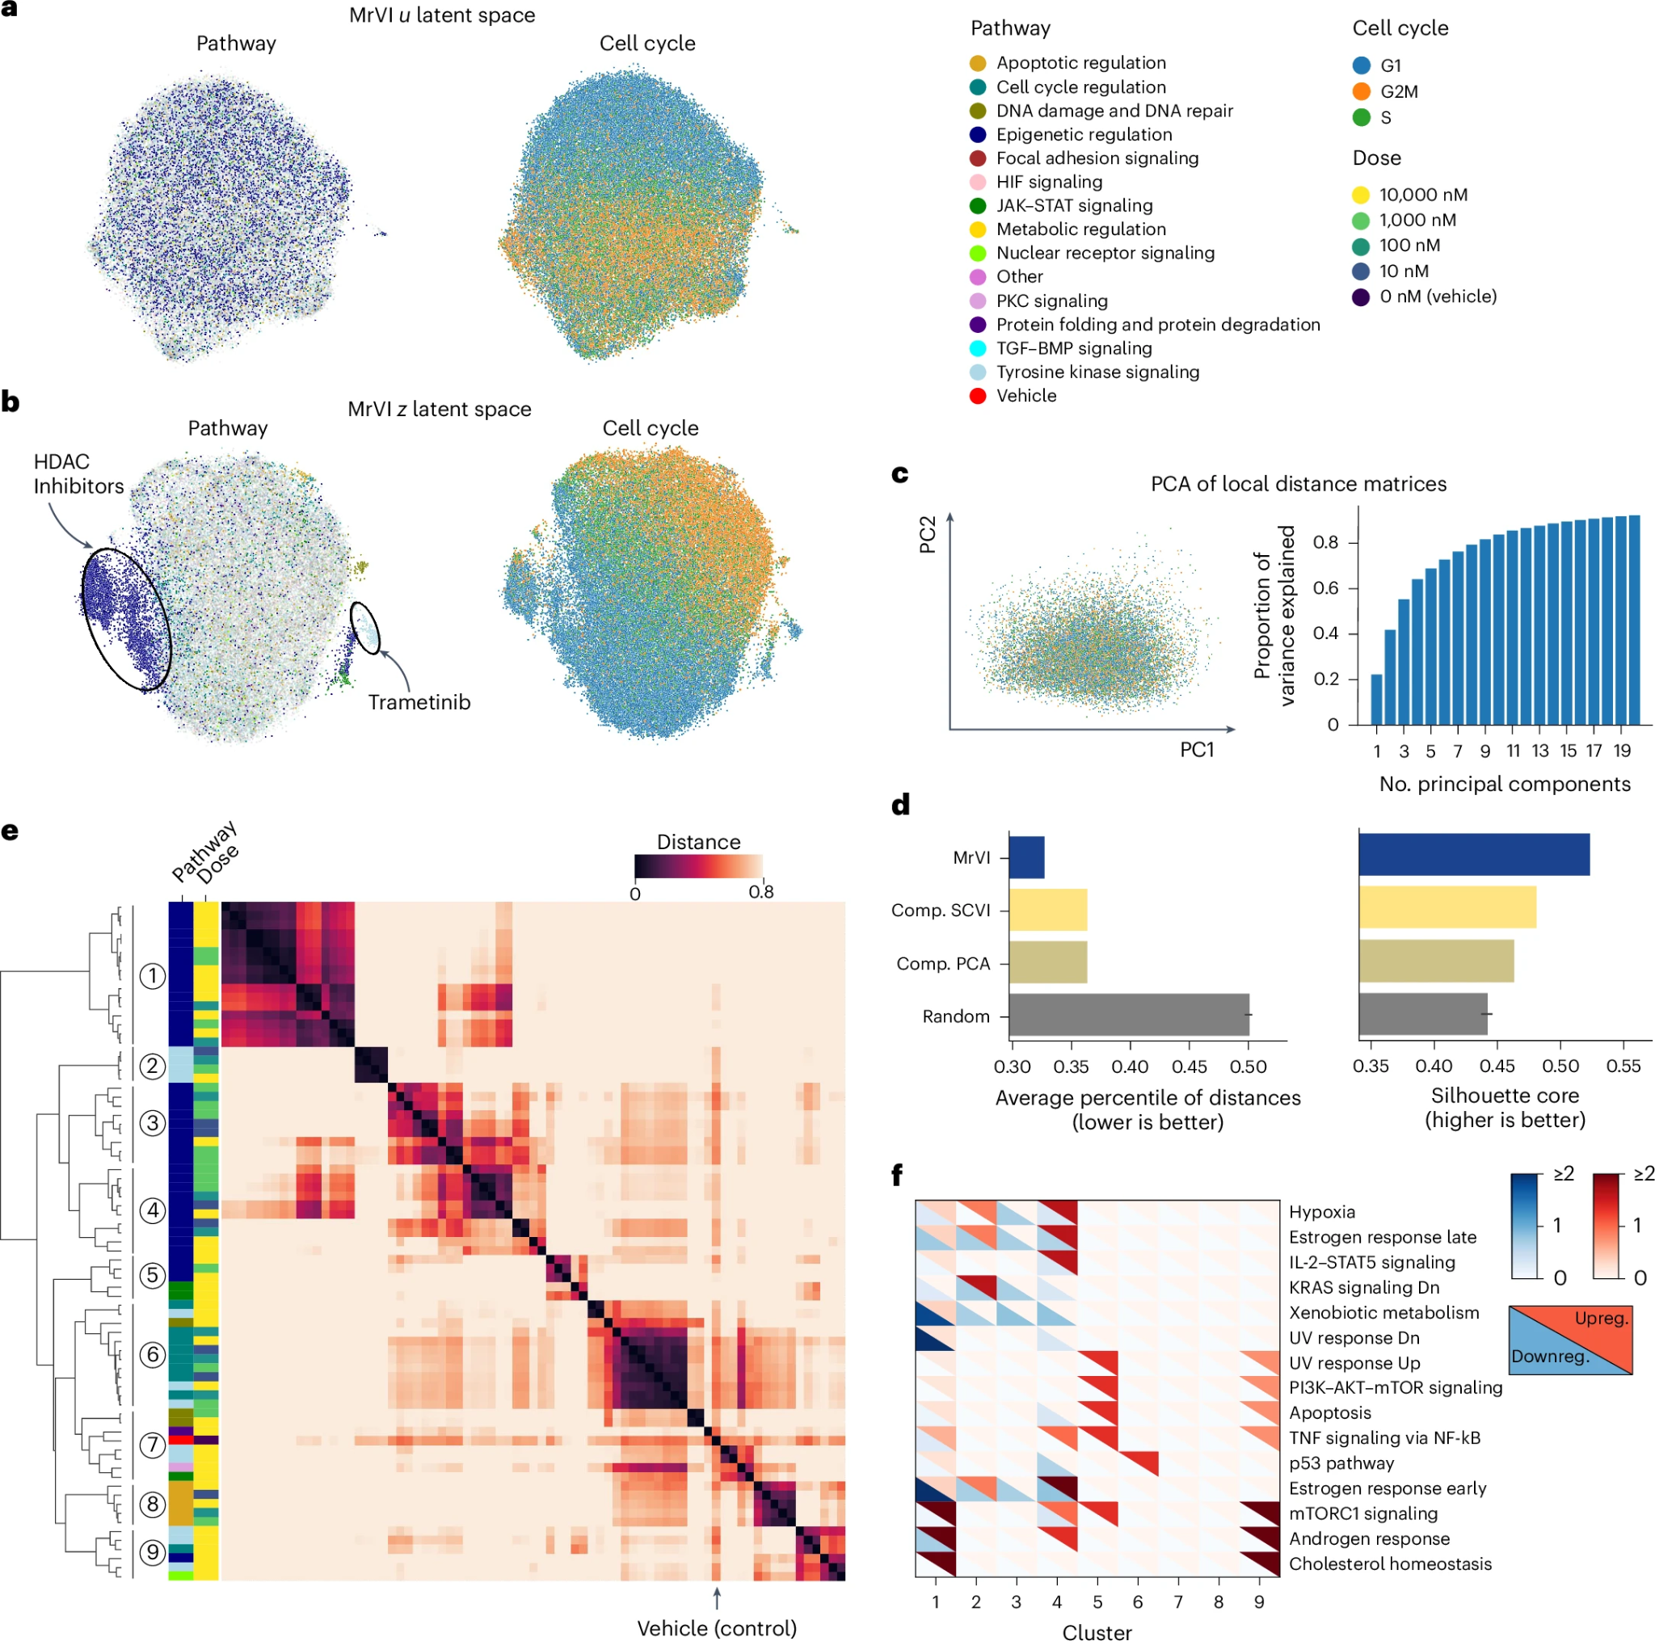
Case Study (2): MrVI enables grouping and characterization of small molecules in screening assays
Distinct subclusters emerge,
each corresponding to specific drug classes
such as HDAC inhibitors or Trametinib (MEK inhibitor)

Slide 61
Notes:
A cohort is a group of individuals who share a common condition — for example, patients diagnosed with the same disease or receiving the same therapy. In this study, the cohort consisted of 234 patients with non-small-cell lung cancer (NSCLC) who received neoadjuvant anti-PD-1 therapy combined with chemotherapy.
Studying such a large cohort allows the researchers to link molecular-level profiles — like each patient’s immune-cell composition, gene-expression pattern, or TCR clonotypes — to their clinical outcomes, such as pathologic response or recurrence-free survival. In other words, they can connect what’s happening inside the tumor at the cellular level with what happens to the patient after treatment.
Of course, not all variation directly represents the biology we want to study. Some variation comes from biological covariates — for example, differences in age, sex, or PD-L1 expression. These are genuine biological traits, but they can blur the specific signal we’re interested in — which is immune heterogeneity. Other variation comes from technical factors, like sequencing depth or batch effects, which are purely experimental noise. By analyzing many patients together and applying normalization or statistical corrections, the study can model and account for these sources of variation so the true biological relationships — between immune architecture and therapy response — stand out more clearly.
Once those confounding factors are accounted for, the remaining differences between patients — the ones that reflect how their immune environments are truly built — become highly meaningful.
And that’s exactly what the next part is about: how a cohort-based single-cell study turns patient-to-patient diversity into biological insight.

